Slide 1

Differential Gene Expression
Notes:
So from here we’re going to transition to learning about some common bioinformatics and machine learning analyses. In this particular section, we’re going to look at differential gene expression.
Reminder: we want to find what genes, processes, pathways are differentially expressed in tumor vs normal tissue

Slide 2
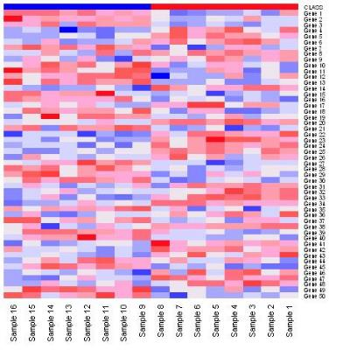
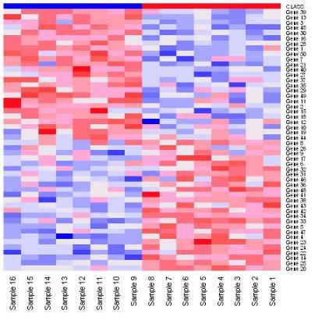
Differential Expression Analysis
Marker selection
Given phenotypically distinct classes, find “markers” that distinguish these classes from one another
Tumor
Normal
Tumor
Normal
Notes:
To begin with, let’s think back to the data that we’ve just prepared.
Okay, so we have 40 samples, some of these are tumor samples and some of these are normal samples. And for each sample, we have we have a numerical value indicating whether that gene is up-regulated or down-regulated in that sample.
In the last section we viewed a heat map of our data and it should have looked something like what you see up there on your left. Remember, the columns are samples. The rows are genes. Red is up-regulation. Blue is down-regulation. White is in the middle - neither up- nor down-regulated.
As you can see, the colors are kind of all over the place in our data. What differential expression analysis does: is given two or more distinct classes - in this case tumor and normal - it finds the markers that best distinguish each class. That is, it’s going to sort our data by the genes whose expression differs the most between the tumor samples and the normal samples.
Ideally it’s going to produce a heatmap with a distinguishable diagonal separation like you see on your right. Here you can see the genes at the top are clearly up-regulated in tumor and down-regulated in normal. And that’s less and less the case as you move downward, until at the bottom the genes are clearly down-regulated in tumor and up-regulated in normal.
And from this we can conclude that the genes at the top and bottom best distinguish our two phenotypic classes, while the genes in the middle distinguish them the least.
I also want to note that in differential expression, the markers don’t have to be genes. They could be processes or pathways. But in this section, our data uses genes. Later when we get to GSEA, we’ll talk about using gene sets.

Slide 3
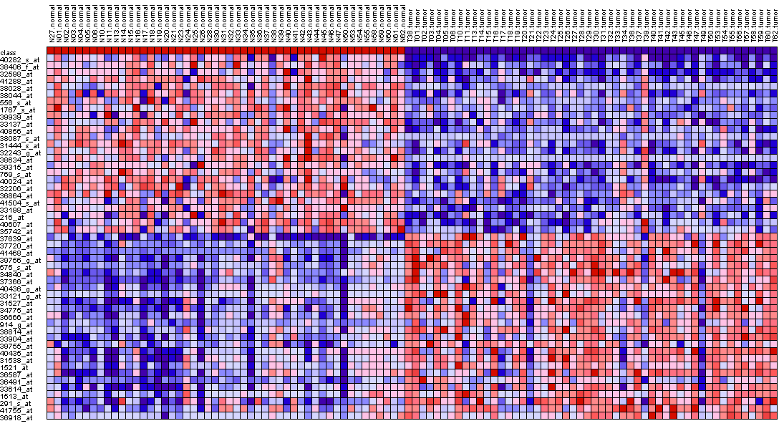
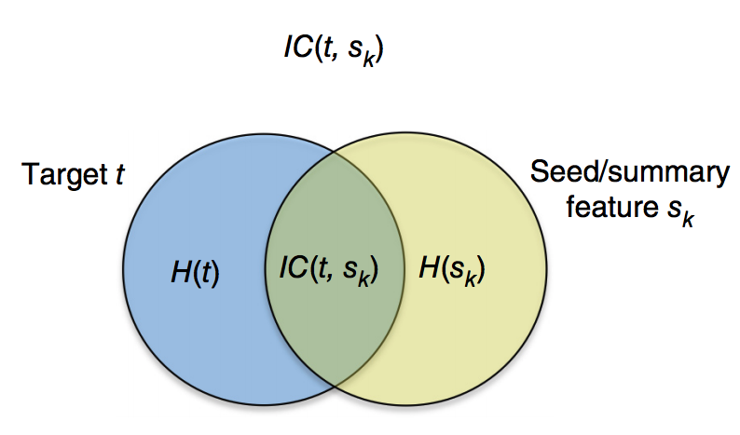
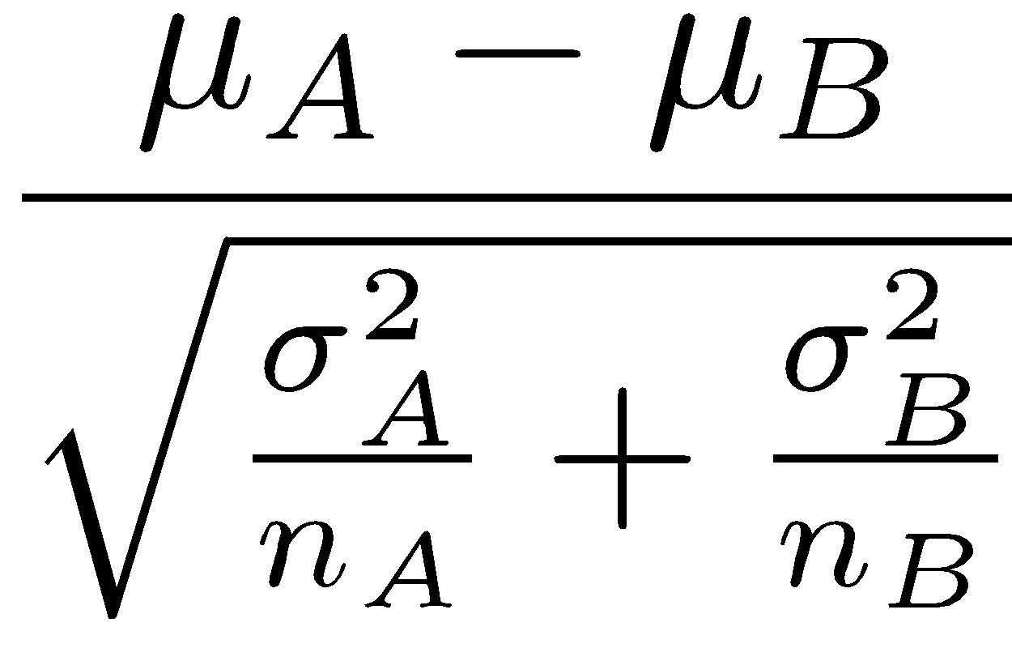
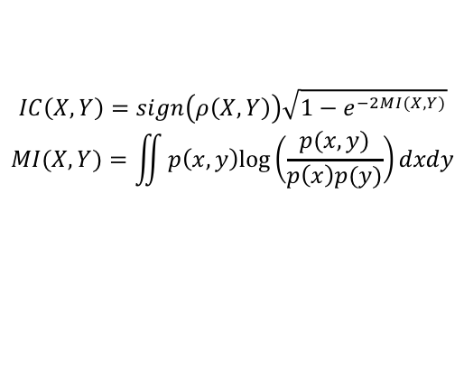
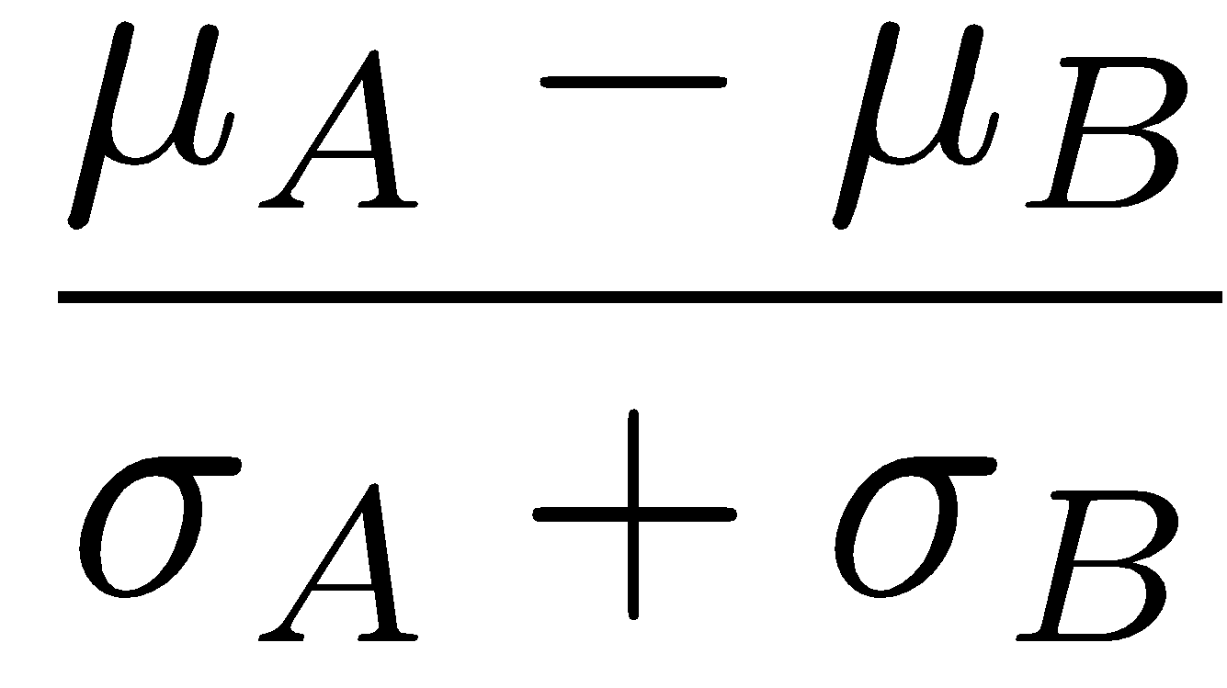
Gene Marker Selection
Compute score for each gene
Compute
score:
t-test,
SNR,
IC,
etc.
Ranked gene list
Dataset
Score
Phenotype/
class labels
μ = class mean
σ = std deviation
n = # of samples
Signal-to-Noise
Ratio (SNR)
Information coefficient (IC)
This test takes the amount of shared information between the two classes.
t-test
Hypothesis testing method:
It is the difference between the mean expression of class A and class B divided by the variability of expression.
Similar to the t-test but takes the standard deviation of the two distributions into account which is more representative of the differences between classes when there may be differences between the SD of class A and the SD of class B.
Notes:
Now, if you’re thinking this through, you might be thinking to yourself: Okay, that makes a pretty visualization, but how are they calculating the difference between the expression of the different genes. In other words: Show me the math!
Like so many things in statistics, there are different ways to do this. And there are people out there who will evangelize one particular distance metric over another.
That’s a rabbit hole I’m not going to go down in this presentation. And the statistical nuances could take up a full day’s workshop anway. But suffice to say, there are different measures for doing the ranking. And these include: a t-test, signal-to-noise ratio, information coefficient, Wald statistic and more.
For now we’re going to stick to this notebook’s default, which is, I believe, a pearson t-test. Because it’s a fairly good measure and it’s quick to compute.

Slide 4
Differential Analysis Exercise
Open notebook:
BioITWorld Differential Analysis
Notes:
‹#›
I’ve rambled on for long enough. So let’s start going through the notebook for this section. You can find it by searching for it by name, it’s up there on the screen. Just start going through it on your own. Raise your hand if you encounter any questions. And I will just back in with some more explanation once we get towards the bottom.
---
Both raise the bar for calling something significant (i.e., smaller nominal p-values are required as the number of hypotheses tested increases)
In practical terms, the FDR is the expected false positive rate; for example, if 1000 observations were experimentally predicted to be different, and a maximum FDR for these observations was 0.10, then 100 of these observations would be expected to be false positives.

Slide 5
Differential Analysis Exercise
Open notebook:
2019-03-07_04-01 Stanford Differential Analysis 2
Notes:
‹#›
Both raise the bar for calling something significant (i.e., smaller nominal p-values are required as the number of hypotheses tested increases)
In practical terms, the FDR is the expected false positive rate; for example, if 1000 observations were experimentally predicted to be different, and a maximum FDR for these observations was 0.10, then 100 of these observations would be expected to be false positives.

Slide 6
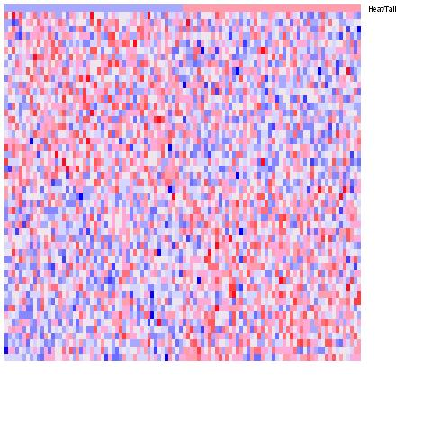
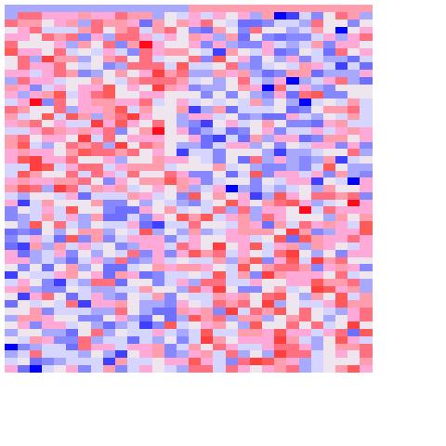
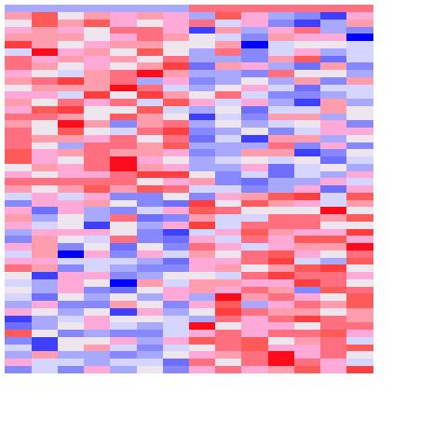
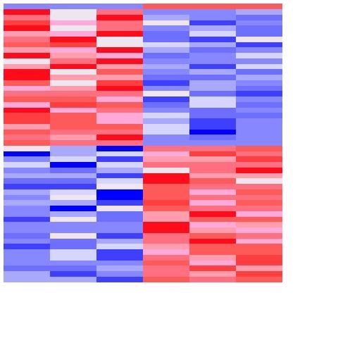
Effect of Sample Size
Exercise: select markers for random samples
Generate a 10,000x100 matrix of random data 🡪 N(μ=0, σ=0.5)
Pick n columns at random 🡪 n = [100, 30, 14, 8]
Assign label yellow (e.g., tumor) to half of samples (chosen at random) and green (e.g., normal) the rest
Select top 20 markers for yellow, top 20 markers for green
Yellow Green
Yellow Green
Yellow Green
Yellow Green
20
20
100 samples
30 samples
14 samples
8 samples
With small sample size it is easy to find genes considered significant by chance!
With so few samples it is easy to find rows that look the way you want them to!
Notes:
Old notes:
Here we have 4 heatmaps with increasing sample size.
With small sample size, easy to find genes correlated w/ anything
Head/Tail example suggests a way of testing for the significance of the results: is the observed difference in expression bigger than what we can observe with respect to a random phenotype (head/tail)?
Fit the story you want to tell --> With so few samples/columns it is easy to find rows that look the way you want them to look.

Slide 7
Differential Analysis
GenePattern modules 🡪 List notebook instead!
Make list shorter
Create count data set – TCGAImporter
Filter and transform data – PreprocessReadCounts
Make class/phenotype file – ClsFileCreator
Run Differential Analysis – ComparativeMarkerSelection/DESeq2
Choose test statistic (say, Information Coefficient)
View results with ComparativeMarkerSelectionViewer
If enough samples, compute p-values by permutation test (otherwise, use asymptotic test).
Control for Multiple Hypothesis Testing by using the FDR correction
Use HeatMapViewer to view results for top genes
Use GSEA to find gene sets (or pathways) that are enriched in your dataset – coming up after the break!
Notes:
Don't go over all the modules

Slide 8
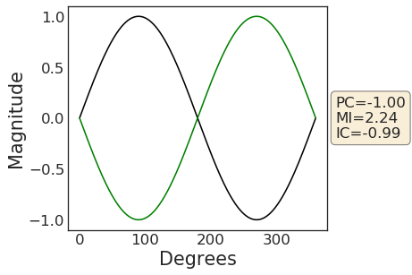
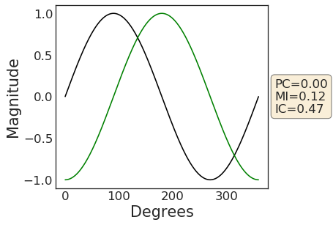
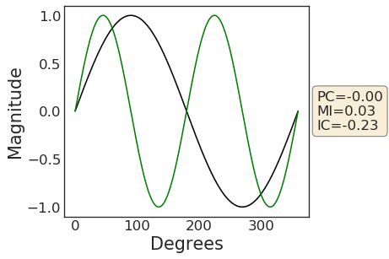
Mutual Information 🡪 Information Coefficient
The Mutual information (MI) quantifies the how well we can predict one variable if we know the other
In general MI, is more sensitive than Pearson correlation (PC). Particularly, unlike PC, MI is sensitive to nonlinear relationships between variables
The information coefficient (IC) is a normalized version of MI to keep its values between -1 and 1
Notes:
Show
+ heatmap turn unto expression profile
Show MI, PC, IC with geeral signals kinda like in distance metrics
Two slides
From Pablo:
The person correlation is a lower bound on the mutual information (the linear correlation part) so in principle, and disregarding approximation limitations, the mutual information should always be more sensitive for establishing association between variables.
Different estimation approaches to the mutual information have different biases and characteristics (sensitivity to noise, intrinsic smoothing etc.) and can produce quite different results when applied to our type of genomic data that has i) complex non-linear associations, ii) significant amount of noise, iii) relatively small number of samples. In addition the running times of different methods can differ by orders of magnitude

Slide 9
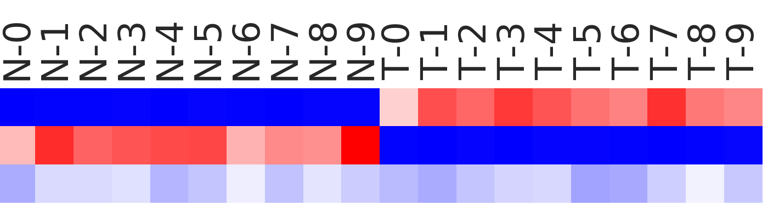
Example: We are interested in computing similarity between the phenotypes labels and a given gene.
PC
MC
IC
+
0.99
1.16
0.95
-
-0.98
0.72
-0.87
0
-0.08
0.002
-0.07

Slide 10
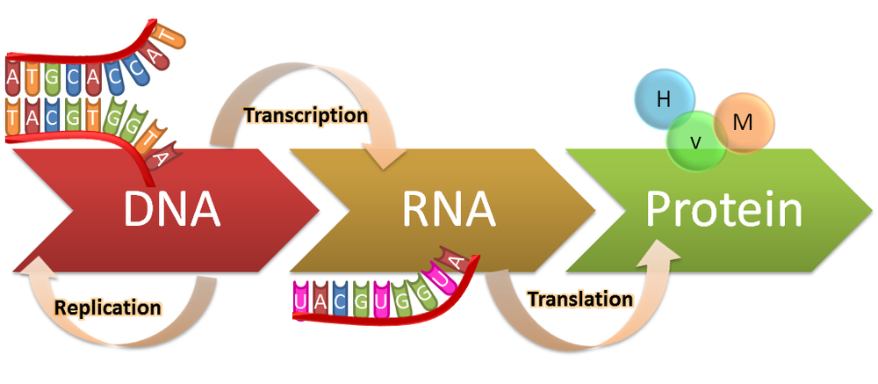
Differential Gene Expression
The “basic units” of DNA are called genes
DNA 🡪 RNA 🡪 Protein
(Central dogma of molecular biology)
Quantifiable “expression” levels
https://genius.com/Biology-genius-the-central-dogma-annotated
Active, ongoing process
Notes:
Proteins are the most interesting of these three, however, they are particularly challenging to quantify at large scales. So we are looking at RNA.

Slide 11

Differential Gene Expression
Gene “A”, condition “1”
E.g., normal cell
Gene “A”, condition “2”
E.g., cancer cell

Slide 12
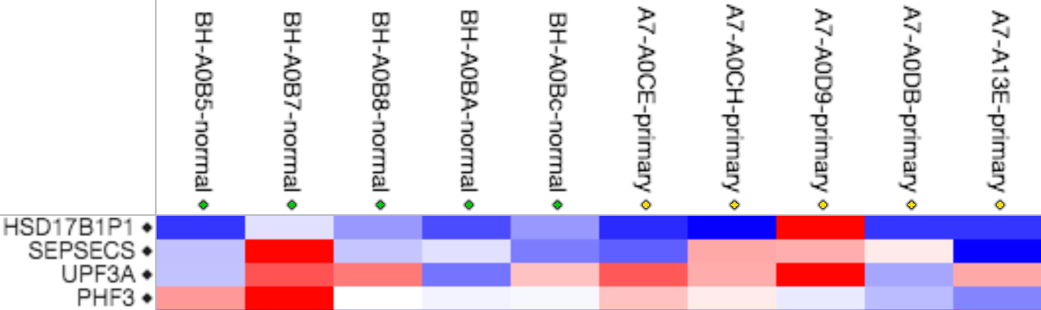
Multiple Hypothesis Testing
Remember: Each gene/row is a hypothesis!
Reduce number of hypotheses/genes by variation filtering (attempt at reducing false negatives)
There are ways quantifying this such as False Discovery Rate
¿
?
¿
?
¿
?
¿
?
Notes:
Multiple Hypotheis. Testing: every time you test a gene, that’s a hypotesis you you increase the probability of getting ”false positive” results by chance.

Slide 13
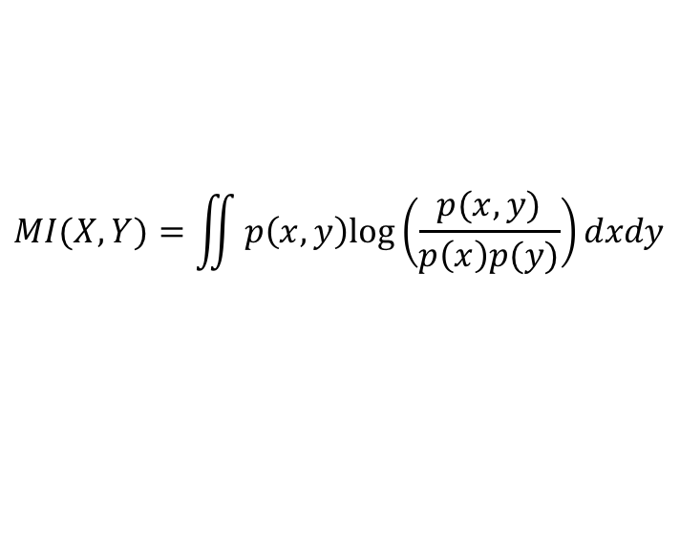
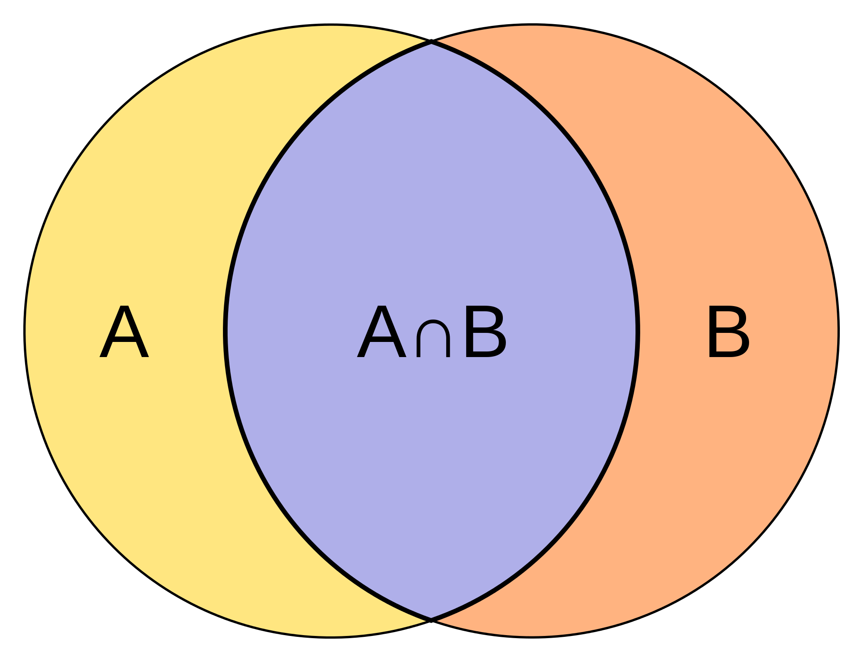
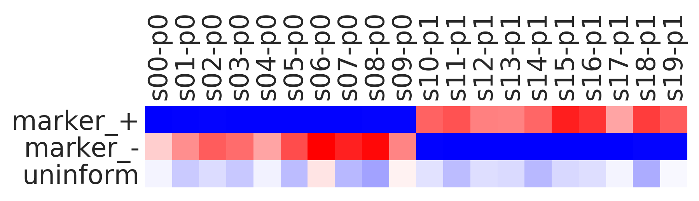
Mutual Information 🡪 Information Coefficient
The Mutual information (MI) quantifies the how well we can predict one variable if we know the other.
MI by analogy is like the intersection between two sets
Example: We are interested in computing MI between the phenotypes labels and a given gene.
Phenotype
Sample #
MI
PC
IC
++ | + | ++
+ | - | --
~0 | ~0 | ~0
Notes:
Show
+ heatmap turn unto expression profile
Show MI, PC, IC with geeral signals kinda like in distance metrics
Two slides

